Slide 1

ASCII Dots

Slide 2
Inspirations
Befunge
Mechanical Computers
ASCII Art

Slide 3
A little about the language
* Dots
* Lines
* Input
* Operators, [] & {}
* Warps
* Storing values and IDs

Slide 4
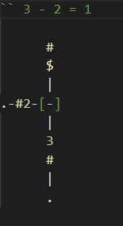
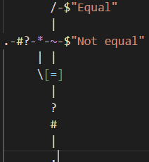
Dots and Lines
* The language can be developed from any text editor and is ran from the command line with the filename preceded by “asciidots”
* The dot begins a live line of code execution (a dot)
* A line continues that dot -,/,\,|,(,),>,<,v,^
* A & kills a dot
* A $ comes before a print ($_, $a#, $#, $’’)

Slide 5

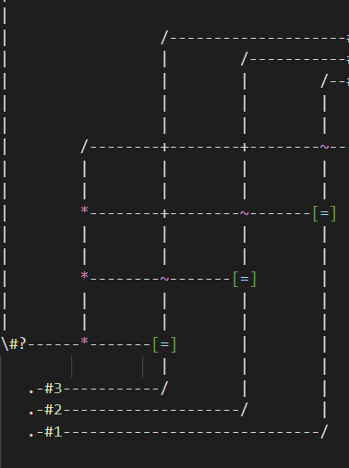

Inputs, storing data, and Operators
* [] and {} ([] outputs upwards and {} horizontally)
* ~ Horz. Entering line exits Vert. if Vert. entering line is 1, continues Horz. Otherwise, we can use a preceding ! On the Vert line for otherwise.
* #? Prompts input and stores that value to the lines (has to be int)
* #n where n is any int stores that value onto the line
* We cannot store strings! We just print the ASCII value of our data
* Warps, jumps to another spot in the program without having to connect lines!

Slide 6
History
* Developed in 2017 as a eso-lang (A language so non-functional that only a handful of people will take the time to learn it)
* Developed by Aaron Janse, et. al
* Inspirations for developing this language included Electrical engineering, mechanical computers, ASCII Art, and the programming language befunge (a perhaps even more interesting language than ASCII Dots)

Slide 7
Thanks for not falling asleep (to those of you still awake)
ESOLANGS ARTICLE: https://esolangs.org/wiki/AsciiDots
REPO: https://github.com/aaronjanse/asciidots?tab=readme-ov-file
DOCUMENTATION: https://ajanse.me/asciidots/language/
LIBRARY DOCUMENTATION: https://ddorn.github.io/asciidots/docs/libs/
MOTHERBOARD ARTICLE: https://www.vice.com/en/article/a33dvb/asciidots-is-the-coolest-looking-programming-language/
Bibliography!

Slide 8
Appendix
See -> https://github.com/daleUrquhart/ASCII-Dots-Project

